Slide 1
Array Representation of Binary Tree
Complete Binary Tree
Heap
Insertion and deletion in Heap
Heapsort

Slide 2
Array Representation of Binary Tree
For storing Binary tree in array, take care of 2 things
Store all elements of binary tree
Preserve the relationship(Who is parent, left child) b/w elements
Formulas are used for maintaining relationship between elements.
If binary tree is filled level by level from left to right, the formulas are automatically satisfied.
If binary tree is filled without using formulas, then fill it from left to right level by level, and leave a blank if any element is missing.

Slide 3
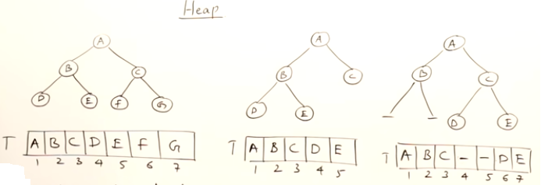
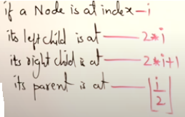
Array Representation of Binary Tree

Slide 4
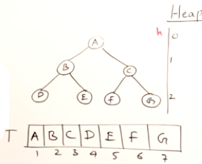
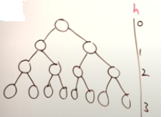
Full Binary Tree: Suppose the height of binary tree(BT) is 2, and in that height, the BT has maximum possible number of nodes. We say that BT is full in height 2.
If u add any node, then its height will increase, if u remove any node, then one node is possible to add.
If height of Binary tree is h, then full BT has 2^{h+1} -1 maximum number of nodes.
Notes:
Binary tree with maximum no. of nodes is called full binary tree.

Slide 5
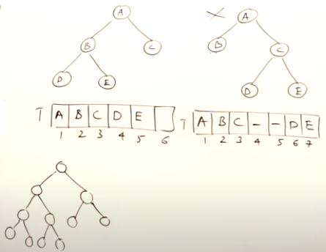
Complete Binary Tree: If we represent a binary tree in array, and there is no empty locations/gaps in between the elements (from first to last element). Then we say the tree is complete binary tree.
Every full binary tree is also a complete binary tree.
Complete binary tree is full binary tree up to height h-1, except the level, which is filled from left to right.
Notes:
In a complete binary tree every level, except possibly the last, is completely filled, and all nodes in the last level are as far left as possible. It can have between 1 and 2^{h} nodes at the last level h. It is also called an almost complete binary tree or nearly complete binary tree. A complete binary tree can be efficiently represented using an array.

Slide 6
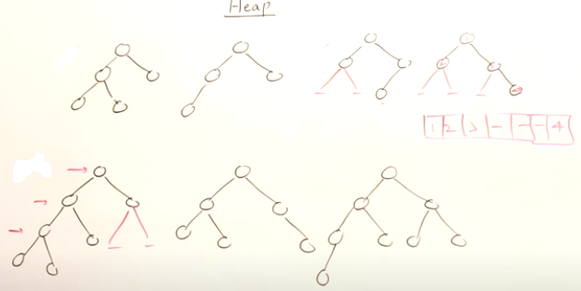
Complete binary tree
Height of complete binary is Logn

Slide 7
Heap
Heap is a complete binary tree , and it has 2 types.
If the heap satisfying the condition that parent node has a value greater than or equal to the values of its descendants. Such heap is called max heap. Maximum element in max heap is at the root.
If the heap satisfying the condition that parent node has a value less than or equal to the values of its descendants. Such heap is called Min heap. Minimum element in min heap is at the root.

Slide 8
Max-heaps (largest element at root), have the max-heap property:
for all nodes i, excluding the root:
A[PARENT(i)] ≥ A[i]
Min-heaps (smallest element at root), have the min-heap property:
for all nodes i, excluding the root:
A[PARENT(i)] ≤ A[i]

Slide 9
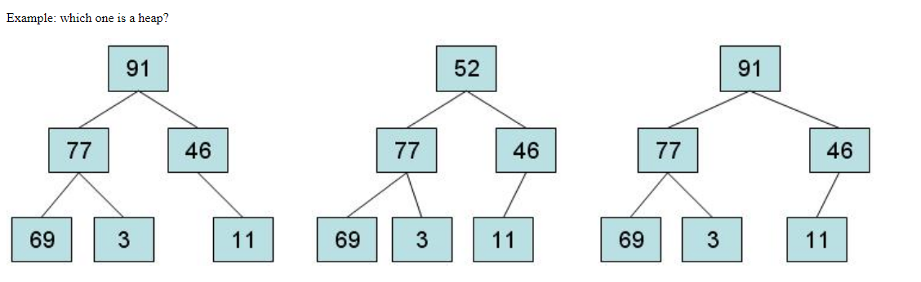

Slide 10
